Slide 1
Ferrari Feature Review

Slide 2
Agenda
Top Ferrari Features
Shared Definitions
Symantec Maximum Repair
SND Firewall
Linux Management
Fast Pathing
Notes:
Speaker = Neal

Slide 3
Top Ferrari Features

Slide 4
Prioritized SEP Ferrari Features
PM Priority | Feature Name | Covered in this deck?
1 | Shared Definitions | Yes
2 | “Fast-Pathing” log forwarding | Yes
3 | Linux Management | Yes
4 | Improve SEPM Content Delta Generation | No
5 | Bandwidth Control for Client Communications | No
6 | SND Firewall | Yes
7 | Enable SNAC HI for SEP Clients | No
8 | Symantec Maximum Repair | Yes
9 | Boot Time Performance | No
Notes:
Neal

Slide 5
Symantec Maximum Repair

Slide 6
Symantec Maximum Repair
Why?
Power Eraser tool used heavily by support, not currently shipped on the DVD
No way for Admins to remotely execute the Power Eraser tool within the SEPM console today
Existing SEP technology doesn’t catch all threats
Notes:
Paul

Slide 7
Symantec Maximum Repair
What?
Integrating the existing Power Eraser (aka Symantec Maximum Repair) engine v3.1.2
Provide a new remote scan type, and associated workflow, for managed SEP clients through the SEPM console
Ability to remotely scan, remediate, and rollback changes on SEP clients
Notes:
Paul

Slide 8


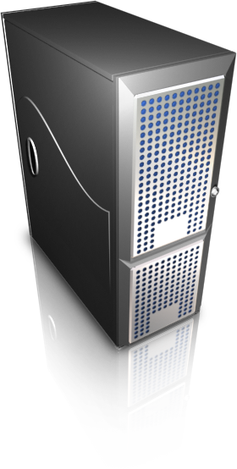
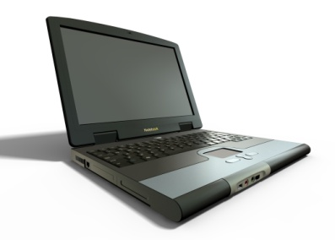
Symantec Maximum Repair – How?
How?
Requires Ferrari (or later) SEPM and Clients
Calling the SMR API’s and adding workflow through SEPM
Scan run on endpoint
Detections follow normal workflow through to SEPM
Remediation action is initiated by admin on SEPM side
No endpoint initiated scans supported
Tool available from SymHelp tool within the product
Scan Execution
Scan Command
Scan Results
SEPM
Remediation Commands
Notes:
Paul

Slide 9
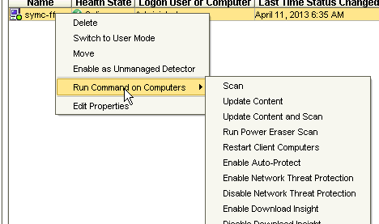
Symantec Maximum Repair – How?
Screenshot shows SEPM Console, “Clients” view
Notes:
Paul

Slide 10
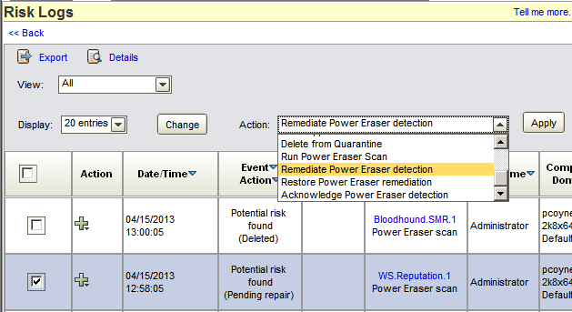
Symantec Maximum Repair – How?
Screenshot shows SEPM Console, “Monitors” view, “Logs” tab
Notes:
Paul

Slide 11
SND Firewall

Slide 12
SND Firewall
Why?
Provide support for IPv6 traffic filtering
Performance improvements for 1Gb+ network speeds
Long-term engineering efficiency; STAR support the driver, single firewall across products
Notes:
Paul

Slide 13
SND Firewall
What?
Existing Firewall driver, “Teefer”, will continue to be available
New SND Firewall integration for Win7 (Win 2K8 R2) and above, Teefer remains for older OS’es
SEPM common firewall rule editor for Teefer, SND, and future Mac Firewalls
“Existing firewall” vs. “enhanced protection”. These are new options for choosing Teefer or SND firewall during SEPM Client Deployment Wizard
Notes:
Paul

Slide 14
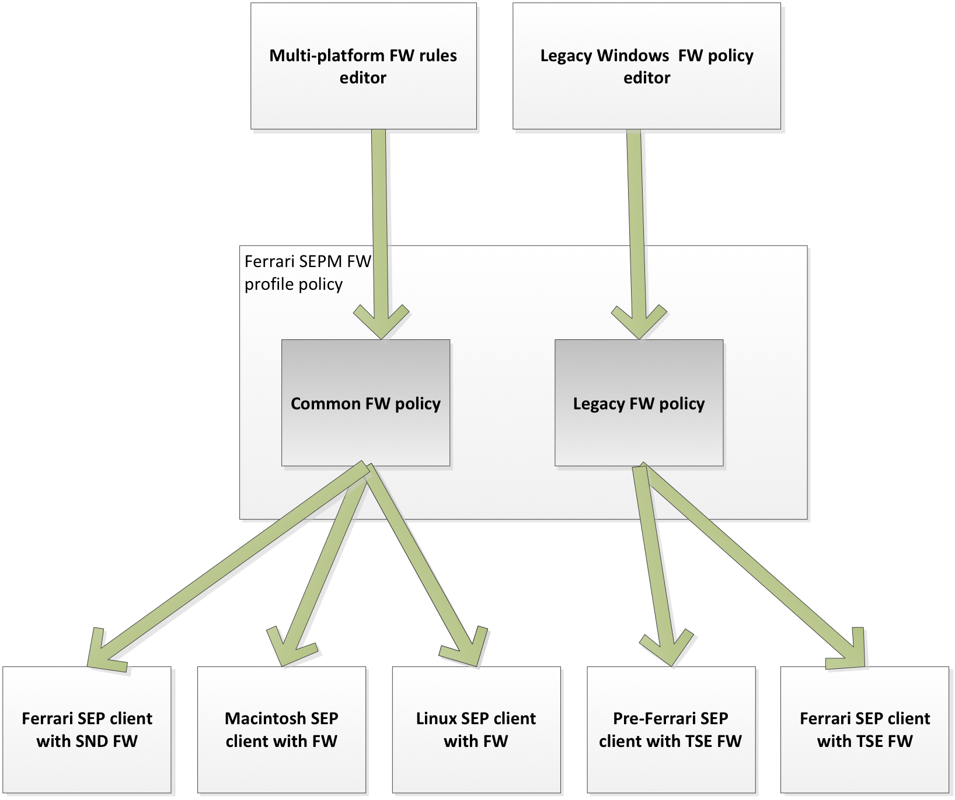
SND Firewall – How?
Notes:
Paul

Slide 15
SND Firewall – How?
Implementation Details
Integration at the WFP layer | Allows greater performance as the system is no longer decoding packets twice (old way: both teefer and OS were decoding packets) SND hooks into layers after tunneling and encryption have been processed, so the SND FW can effectively see into and filter this traffic, something the Teefer Firewall could not do
New SEPM firewall rule editor | New Firewall rule editor can manage Teefer, SND and the planned Mac Firewall rules The SND Firewall feature set is a subset of the Teefer feature set The Mac Firewall is under development and targeted for the “Porsche” release of SEP SND firewall policy can be transformed into the old Teefer forms, allowing for backwards compatibility where required
STAR Changes | SND added Layer 2 support (MAC level), SNAC P2P support, a number of “don’t shoot self in foot” features, wildcard support and unmanaged client detection support (LAN Sensor). MD5 was also added to support backwards compatibility in Application Learning Smart WINS, Smart DNS, Smart DHCP and Smart Gateway When turned on each allows their own traffic through regardless of policy CIDS was modified to support SEP’s Auto-Block and Port Scan
Notes:
Paul

Slide 16
Linux Management

Slide 17
Linux Management
Why?
Symantec Linux customers are upset with the lack of integrated management and Symantec has lost credibility with unmet promises
Linux usage is increasing
Our competitors are taking advantage of our weakness here and winning both Linux and Windows seats from Symantec
Notes:
Paul

Slide 18
Linux Management
What?
Client communication settings management
Policy management for Virus, Spyware Protection, LiveUpdate and exception policy management
Logs, Opstate, Reports and Monitors
Broad Linux distribution support: Red Hat, SUSE, Debian, Ubuntu, Oracle, Fedora
Notes:
Paul

Slide 19
Linux Management – How?
Akamai
Live Update
Policy & Commands
SEPM
Opstate & Logs
Linux Endpoints
Notes:
Paul

Slide 20
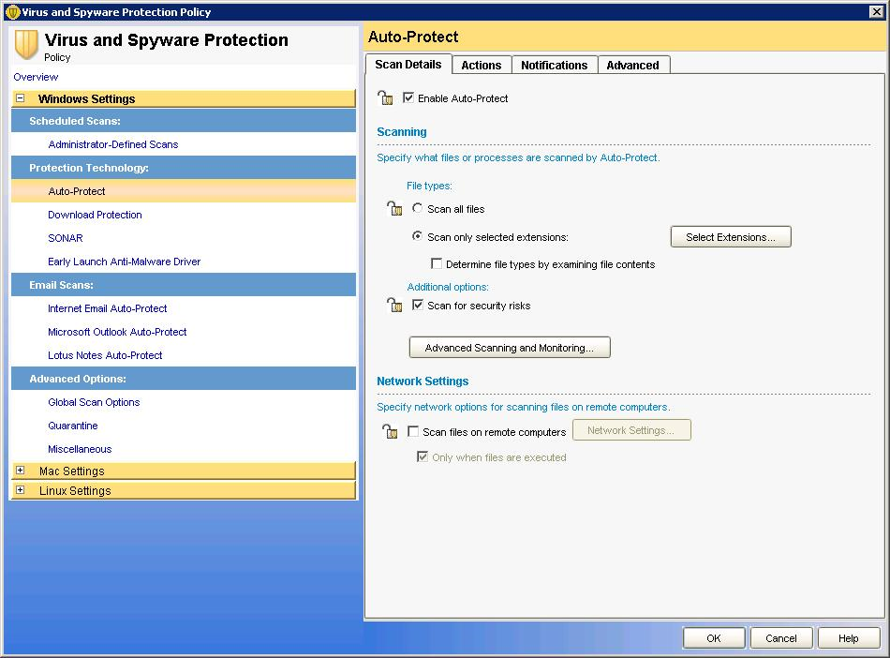
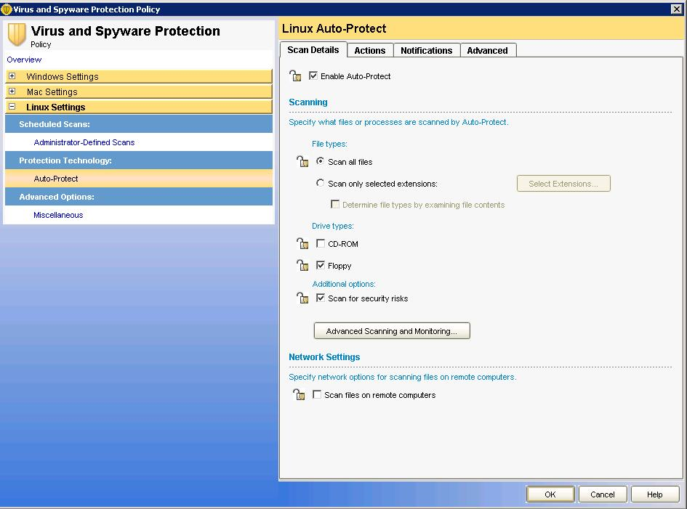
Linux Management – How?
Mgmt features modeled after Windows
UI as close to existing Windows UI as possible
Slight variations where necessary

Slide 21
Fast Pathing

Slide 22
Fast Pathing
Why?
Wells Fargo request to have detection events immediately forwarded to SEPM, rather than waiting for configured heartbeat interval
What?
Override heartbeat configuration for high priority events such as threat detections
How?
The client checks the events log every minute
If there is a “priority” event, the client sends data to SEPM
All the AV and security events (even non-priority events)
Corresponding OpState (to ensure that detection information arrives)
Notes:
Paul

Slide 23
Shared Definitions (Network Based Definitions)

Slide 24
Shared Definitions
Why?
Reduce IO storms in virtual environments caused by concurrent LiveUpdate sessions
Reduce SAN storage requirements caused by definition duplication
Non-persistent VDI use case exacerbates this issue
We are losing deals to competitors who offer solutions to this problem (e.g. Trend’s “Agentless” solution, McAfee’s MOVE solution)
Notes:
Neal

Slide 25
Shared Definitions
What?
Majority of AV definitions are offloaded to a network share hosted on a virtual appliance
Clients discover the closest available virtual appliance, hosted AV definitions are used during scans on the endpoint
Support for all major hypervisors possible
Current testing will only cover VMWare
Notes:
Neal

Slide 26
Shared Definitions – How?
Data Center 1
Data Center2
Cluster A
SAN
Cluster C
SAN
ESX
ESX
ESX
ESX
ESX
ESX
ESX
ESX
GVM
GVM
GVM
GVM
Defs VA
GVM
GVM
GVM
GVM
Defs VA
Defs VA
Defs VA
GVM
GVM
Cluster B
SAN
ESX
ESX
ESX
ESX
GVM
GVM
GVM
GVM
Defs VA
Defs VA
GVM
As GVMs are vMotioned, the GVM in question will find the closest Defs Host within 10 minutes
Notes:
Joao

Slide 27
Shared Definitions – How?
Virtual Appliance
Cent OS 6.3
Samba share to host definitions – v3.5
VA configuration including the content policy is managed via SEPM
Command Line Interface
Automated deployment workflow
Product includes tools for deploying VAs along with sample scripts to automate the entire deployment
Notes:
Joao

Slide 28
Shared Definitions – How?
Implementation Challenges
Discovery | SEP Client on the GVM needs to seamlessly connect to the best VA out-of-the-box Closest VA is determined using ping & download test using raw sockets. List of VA’s is tracked by SEPM Periodic network test performed to ensure connectivity to current host has not significantly changed (a vMotion action could affect connection speed)
Performance | Must ensure that the discovery solution doesn't use unnecessary network bandwidth and/or cause unwanted switching of VAs if the bandwidth is low or pipe is too busy VA based solution builds on the premise that network I/O is cheaper and is an acceptable trade-off compared to disk I/O
QA Challenges | Good statistical variance on slow networks for discovery Not so deterministic on high speed networks
VA = Virtual Appliance
SVA = Security Virtual Appliance
Notes:
Joao

Slide 29
Appendix

Slide 30
Recorded Demos
Shared Definitions
http://edu.qalabs.symantec.com/qau/pg/pages/view/2509
SMR
http://edu.qalabs.symantec.com/qau/pg/pages/view/2536
SND Firewall
http://edu.qalabs.symantec.com/qau/pg/pages/view/2519
Linux Management
http://edu.qalabs.symantec.com/qau/pg/pages/view/2562

Slide 31
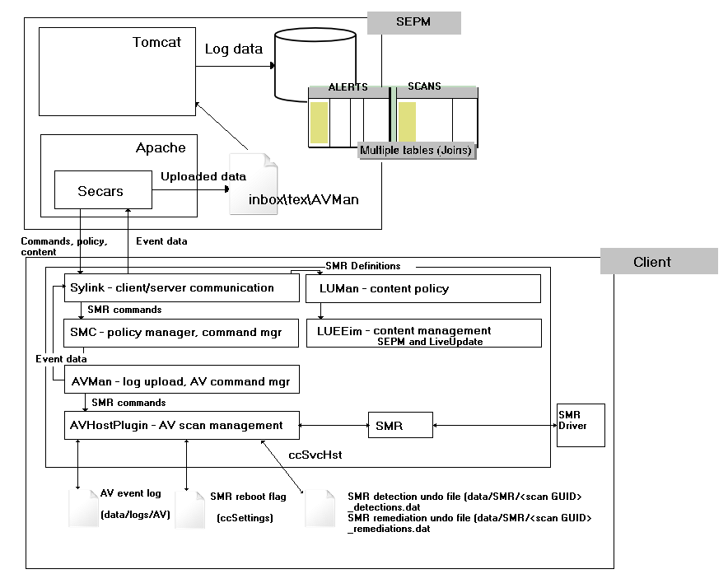
Symantec Maximum Repair
Notes:
Paul

Slide 32
SND Based Firewall
SEP
CIDSTIM (interface to CIDS) CIDS, AutoBlock, PortScan
Tse.dll (interface to Teefer)
Custom IPS, 3rd Party Driver
SNDTIM.dll (interface to SND)
Firewall, LAN Sensor, P2P, “Smart” features
User Mode
Windows
Network Stack
Kernel
CIDS
SymNetDriver (SND)
Windows Filtering Platform (WFP)
Tcpip.sys
Layer 4
Layer 3
Custom IPS
(SEPCustomIPSlw.sys)
3rd Party Driver Support
(SEPNetLW.sys)
NDIS
Layer 2

Slide 33
Teefer Based Firewall
SEP
CIDSTIM (interface to CIDS)
CIDS feature
Tse.dll (interface to Teefer)
FW, Custom IPS, P2P, LAN sensor, AutoBlock, PortScan
User Mode
Windows
Network Stack
Kernel
CIDS
SymNetDriver (SND) Supporting Role Only
Windows Filtering Platform (WFP)
Tcpip.sys
Layer 4
Layer 3
Teefer
NDIS
Layer 2
Presentation Identifier Goes Here
33

Slide 34
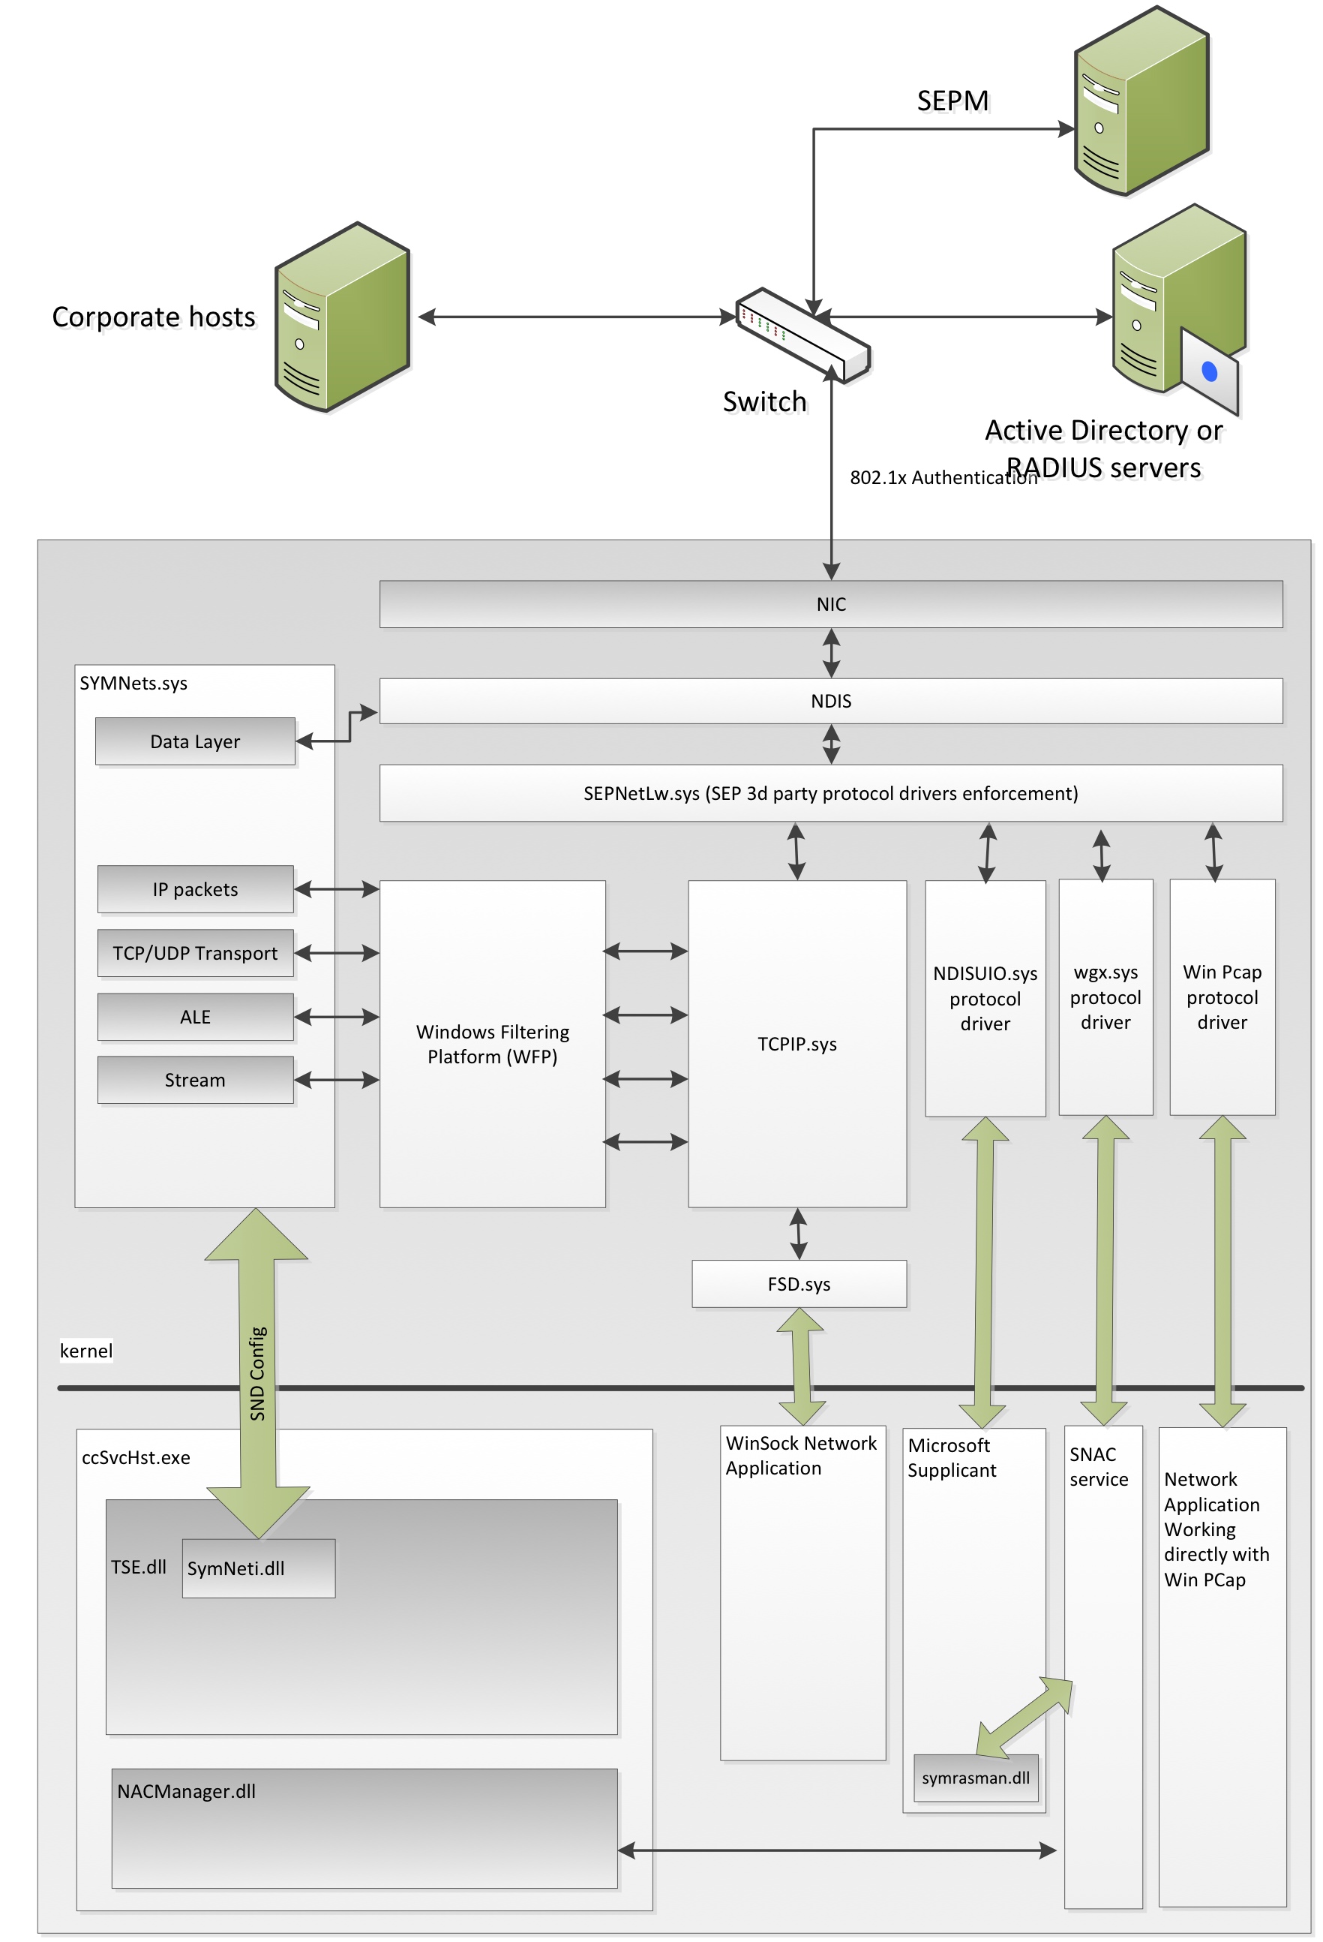
SND Firewall
Notes:
Paul

Slide 35
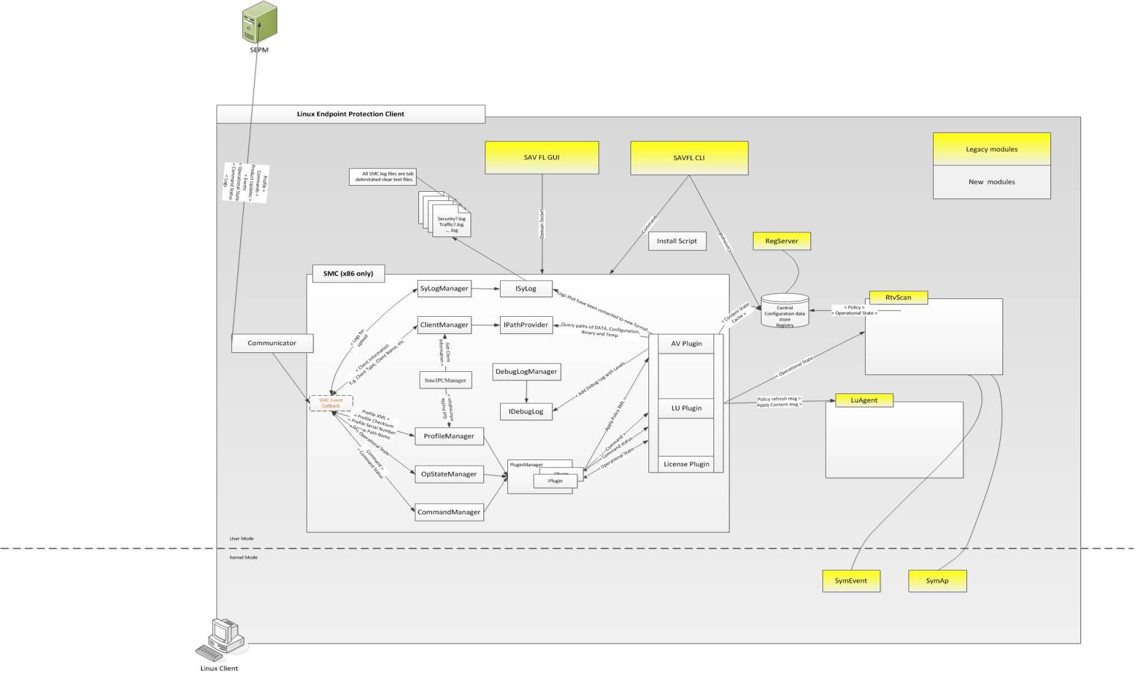
Linux Management – How
Linux Client Architecture
Notes:
Paul

